Slide 1

Task 1
Web scraping to gain company insights
Scrape and analyse customer review data to uncover findings for British Airways
29/08/2023

Slide 2
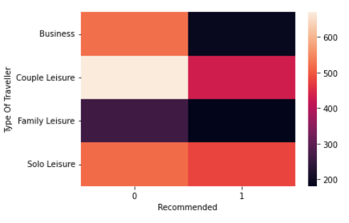
INSIGHTS FROM CUSTOMER REVIEWS
British Airways should take note that among all types of travelers, the 'Couple Leisure' category has provided predominantly negative reviews and a majority of them have not recommended the airline. This signals an area of improvement for British Airways.

Slide 3
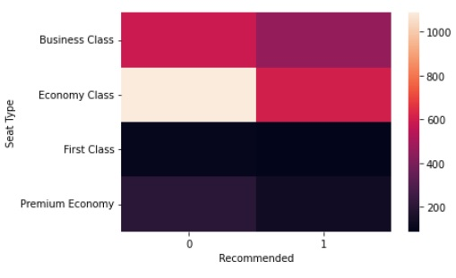
INSIGHTS FROM CUSTOMER REVIEWS
Among all the seat types, it's noteworthy that first-class and economy-class passengers have provided unfavorable reviews, with a majority of them not recommending British Airways. This highlights the need for British Airways to make improvements in this regard.

Slide 4
INSIGHTS FROM CUSTOMER REVIEWS
Among all the seat types, it's noteworthy that first-class and economy-class passengers have provided unfavorable reviews, with a majority of them not recommending British Airways. This highlights the need for British Airways to make improvements in this regard.

Slide 5
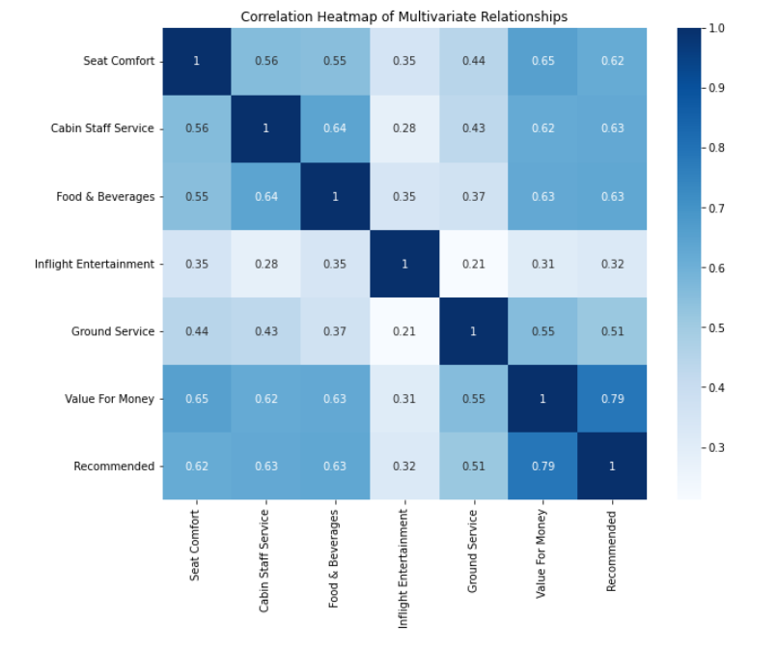
INSIGHTS FROM CUSTOMER REVIEWS
As we can observe, Seat Comfort, Cabin Staff Service, Food & Beverages, and Value For Money are the areas that significantly influence positive customer reviews and recommendations. These areas exhibit a correlation of greater than 60% with the recommendation. Therefore, it is imperative for British Airways to prioritize the improvement of these aspects, as they wield a substantial influence on positive reviews.

